Slide 1
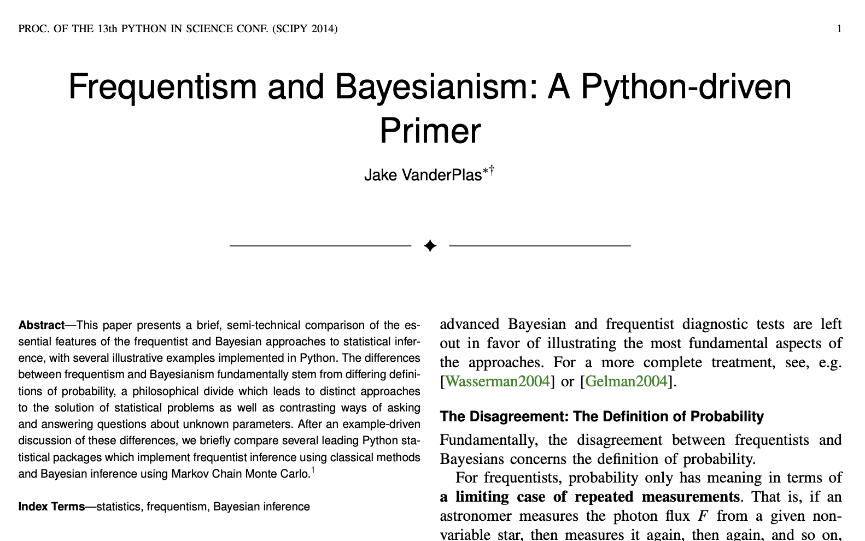

HOMEWORK 1
Jake VanderPlas

Slide 2
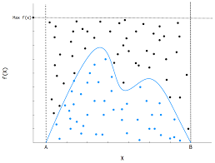
(Optional) Jupyter notebooks:
FreqBayes1
FreqBayes2
FreqBayes3
FreqBayes4
FreqBayes5
Examples of Bayesian regression, hypothesis inference, and MCMC chains.

